Slide 1
Chapter 5: Measures of Dispersions
Part-1

Slide 2
Learning Outcomes
After Completing the chapter ,you will able to know :
How to measure spreadness of data values by calculating dispersion.
Different types of measures of Dispersion with their application ansdlimitations.

Slide 3
Contents
    From this lecture, you are going to learn…
What is dispersion?
Discussion on Range, Mean deviation, Population variance and standard deviation.
Examples, Uses and limitations

Slide 4
What is measures of Dispersion?
Dispersion measures the spread or variability of a set of observations among themselves or about some central values.
Example: Group-1
Marks of 4 students out of 100.
50, 49, 51, 50.
Mean = 50
Small Dispersion/ variation
High uniformity
Example: Group-2
Marks of 4 students out of 100.
100, 100, 0, 0.
Mean = 50
Large Dispersion/ variation
Low uniformity

Slide 5
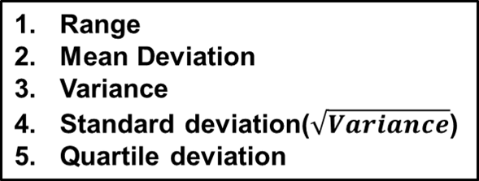
Types of measures of dispersion
Measures of Dispersion
Absolute measures
Relative measures
Coefficient of Range
Coefficient of Mean Deviation
Coefficient of Variation(c.v.)
Coefficient of Quartile deviation

Slide 6
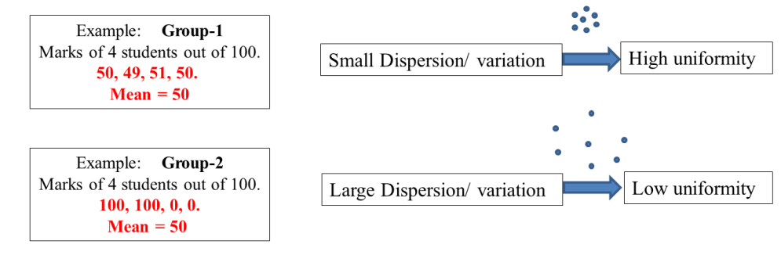

Purpose of
Studying Dispersion
Purposes of measures of dispersions:
To measure the spread of the data set.
To determine the reliability of an average.
To compare two or more data sets according to their variability.

Slide 7
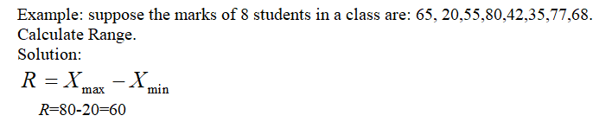
Range
1. Range: Simplest measure of dispersion is the range.
Range = Largest value – Smallest value
Limitation:
Range cannot tell us anything about the character of the distribution within two extreme observations

Slide 8
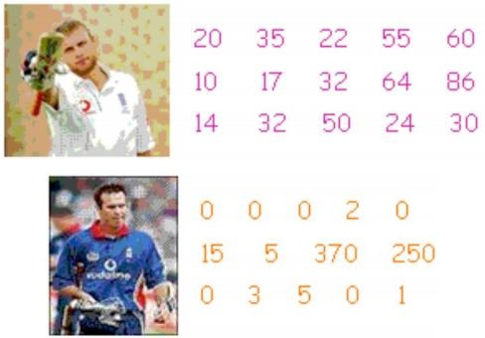
Example of Range
Average run of Batsman A =36.73
The variation of the run of Batsman A = 86-10=76
Average run of Batsman B = 43.4
The variation of the run of Batsman B = 370-0=370

Slide 9

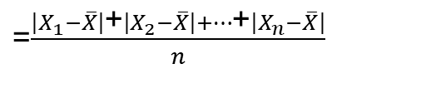
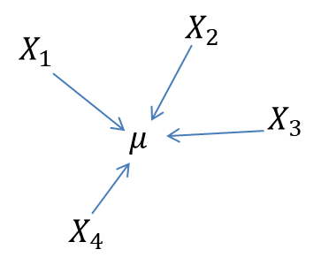

Mean deviation
Mean Deviation: The average of the absolute values of the deviations from the average of the data.
Mean deviation is obtained by calculating the absolute deviations of each observation from mean and then averaging these deviations by taking arithmetic mean.
Formula:
3
2
-.5
.5
2.5
1
1.5
-1.5
4

Slide 10
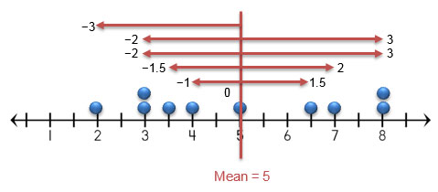
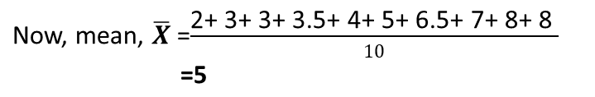
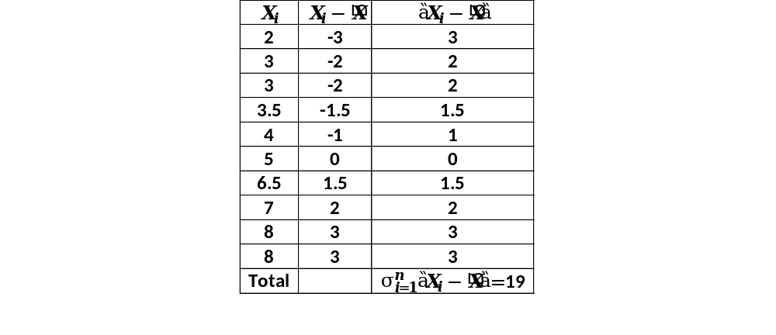


Example of Mean deviation
Example:
Find the Mean Deviation of data values are
2, 3, 3, 3.5, 4, 5, 6.5, 7, 8, 8.

Slide 11

Merits and limitations of Mean Deviation
Merits:
Less affected by the values of extreme observation.
limitations:
The greatest limitation of this method is that algebraic sings are ignored while taking the deviations of the items.

Slide 12
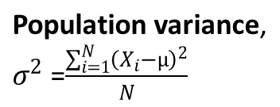
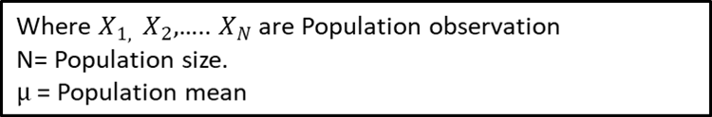
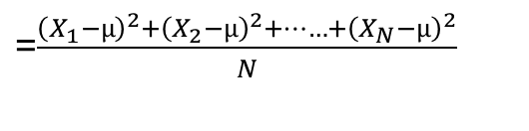


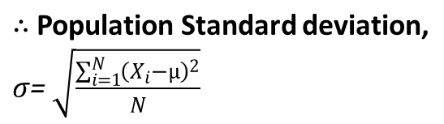




Population Variance and Standard Deviation

Slide 13
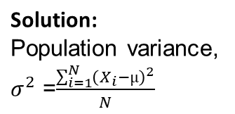




Example of Population Variance and Standard Deviation
Example: Calculate the population variance and standard deviation for the data set 1, 2, 2, 3, 4, 5.
= 2.83

Slide 14
Exercise of Population Variance and Standard Deviation
Exercise:
Set A: 18, 25, 10, 12.
Set B: 32, 30, 20, 10.
Find population standard deviation and compare the variability between these two data sets.
**Hints: Find Standard deviation for both the data. Then the data set with lower standard deviation will have higher uniformity.

Slide 15


